Slide 1
Assessing Current and Alternative Financing Products and Delivery Channels in the Agricultural Machinery Market

Slide 2
Methodology
The objective of the study is to unearth the current financing options of value chain actors and identify their financing needs, along with providing innovative financial solutions for both agri-machinery value chain actors and formal financial institutions
Panchagarh
KIIs Conducted
4 Manufacturers and Importers
Thakurgaon
Nilphamari
Lalmonirhat
Dinajpur
Rangpur
Kurigram
Surveys Conducted
11 SMEs
15 MSMEs
Joypurhat
Gaibandha
Sherpur
Naoganon
Jamalpur
Netrokona
Sunamganj
Sylhet
Nawabganj
Bogra
Financial System Actors
4 PCBs
2 SOBs
1 NBFI
1 DFS
1 Agent Banks
3 MFIs
Mymensingh
Rajshahi
Natore
Sirajganj
Kishoreganj
Maulvibazar
T
angail
Habiganj
Surveys Conducted
14 SMEs
14 MSMEs
12 Dealers
54 MSPs
1 FGD of MSPs
Pabna
Gazipur
Narsingdi
Kushtia
Manikganj
Dhaka
Brahmanbaria
Surveys Conducted
5 SMEs
4 Dealers
36 MSPs
1 FGD of MSPs
Meherpur
Rajbari
Narayanganj
Chuadanga
Munshiganj
Comilla
Jhenaidah
Magura
Faridpur
Shariatpur
Chandpur
Khagrachhari
Narail
Madaripur
Jessore
Gopalganj
Feni
Barisal
Lakshmipur
Ecosystem Builders
1 Bangladesh Bank
1 MRA
1 BEIOA
1 Development Agencies
Jhalokati
Noakhali
Rangamati
Khulna
Pirojpur
Bhola
Chittagong
Satkhira
Bagerhat
Patuakhali
Barguna
Bandarban
Cox's Bazar

Slide 3
Baseline Findings: Business Profile
Workshop: Manufacturer and Engineering Workshops that fix or modify machinery
Jashore and Bogura’s highest sold => liner, piston; fodder chopper
Cox’s Bazar’s highest sold => liner, piston; centrifugal pump
Foundry: Manufacturer, Foundry, and Engineering Workshops that sell spare parts and machinery
Bogura’s highest sold => thresher and centrifugal pump
Jashore’s highest sold => maize sheller and fodder chopper
Dealer: Machinery and spare parts seller with the provision of after-sales service
Cox’s Bazar’s highest sold => combine harvester and tractor
Jashore’s highest sold => combine harvester, tractor, and rice transplanter
MSP: Micro-entrepreneurs who sell machinery services to farmers.
Cox’s Bazar highest sold => tractor, combine harvester and power tiller
Jashore’s highest sold => tractor and combine harvester
Manufacturers and Importers: They are spare parts and components producer, machinery assembler, and CBU importer
Machinery Portfolio => tractor, combine harvester, rice transplanter, and reaper

Slide 4
Broad Overview
Current Market System
Importers source whole machinery using credit lines
Foundries/workshops manufacture whole machines or their parts
Manufacturers/importers distribute on their own or through dealers to end users (MSPs)
Credit sales across the value chain
Foundries
Manufacturer
& Importers
Workshops
BEIOA
Dealers
Banks, NBFIs
MFIs
Broad Themes
Small players (Workshops and MSPs) are getting crowded out in accessing finance
Large importers/foundries face credit recovery challenges from small players
Credit flow dried up across the value chain
Low involvement of FIs due to low recovery guarantee
MRA
Bangladesh Bank
MSPs
Flow of Machinery and Spare Parts Flow of Funds
Flow of Information

Slide 5
Demand Side Analysis: Framework
Lending stages
Pre-lending (Application)
Lending (Loan Processing)
Post-Lending (Repayment)
Decision Point for Actors
Demand side factors to access formal financing
Establishing business model viability of stakeholders
Income generating activities and proof
Unit economics of business
Market prospects of mechanization
Risk appetite for finance
Seasonal product availability
Loan ticket size
Security/collateral
Costs of service access
Channel of delivery
Processing costs (time, fees)
Repayment capacity
Down payment for machines
Timely EMI repayment for hire-purchase and/or loans
Changes in income level throughout the loan tenor
Accessing the required finance from formal institutions

Slide 6
Importers/marketeers generally do not face any challenges in acquiring credit due strong business financials, but do face cash crunch during low recovery period.
Due to higher default rates, FIs demand collateral and business financials that small-scale businesses often fail to provide. Hence, they opt for MFIs where less documents are required.
MSPs usually take credit from MFIs as they do not generally have enough collateral for the loan required and they do not keep track of business financials.
Demand Side Analysis: (Pre-lending)
Foundries
Only one respondent faced collateral issues while the rest did not face any challenges

Slide 7
Demand Side Analysis (Loan Processing)
Lack of insufficient collateral and fees incurred to prepare documents due to lack of awareness leads to ineligibility of acquiring credit and high processing time.
Foundries having higher diversification in their product line that mitigates the risk of default compared to workshops and Dealers.
MSPs generally require credit to pay the down payment of expensive machinery. Since they do not get it because of lack of collateral, they at times take crop-based loans to purchase machinery.
Documents and Collateral Required
Dealers
33% and 50% required business financials in Jashore and Cox’s Bazar
58% and 50% required post-dated cheque in Jashore and Cox’s Bazar
MSPs
50% and 27% required collateral in Jashore and Cox’s Bazar
35% and 36% required personal guarantee in Jashore and Cox’s Bazar
Workshops
55%, 60%, and 57% required business financials in Bogura, Cox’s Bazar and Jashore
73%, 60%, and 86% required collateral in Bogura, Cox’s Bazar and Jashore
Foundries
100% and 57% required business financials in Bogura and Jashore
87% and 71% required collateral in Bogura and Jashore

Slide 8
Demand Side Analysis (Loan Processing)
Workshops and foundries have not been refused on an average 60% of the times in all the regions while over 60% MSPs have not applied due to lack of documentation and knowledge.
Foundries in Jashore mostly take CC (cash-credit) loans with quarterly payment followed by term loan. In Bogura, demand for both the CC and term loans are same.
MSPs prefer MFIs to take credit as loan processing time takes 7 days while banks take over a month. Even though MFIs charge 24% while banks charge 9%, the ease of access to credit from MFIs is preferred.
Foundries
29% in Bogura took CC loan and term loan
53% and 33% in Jashore took CC loan and term loan

Slide 9
Demand Side Analysis (Post-lending)
Workshops and Dealers rely on seasonality to pay their loans, but this is not an issue for Foundries as they have a bigger portfolio of machinery.
Small scale businesses prefer taking credit from MFIs due to flexible payment procedure as they fail to adhere to the EMI structure of banks.
MSPs depend on the income earned from services provided, hence, they prefer cash-based transactions. Due to seasonality impact they often fail to repay loans.
Poor after sales service of machinery also hampers their service provision which reduces their income capacity.
Seasonality Impact of Enterprise Level Players
Workshops
Over 60% claimed highest sales on Feb and Dec in Bogura
Similar claims were in made in Cox’s Bazar for Jan to Feb
Over 75% in Jashore claimed sales peaked in Nov to Jan
Foundries
Over 70% claimed highest sales from Feb to Apr in Bogura
Similar claims were in made in Jashore for Feb to May
In general, sales peaked from Dec to Jun in both the regions
Dealer
Over 55% claimed highest sales from Nov and Mar in Cox’s Bazar
In Jashore, highest sales were recorded from Nov to Apr
In general, sales were low on Jul and Aug in both the regions
Service Provision Mechanism of Individual Level Players
MSPs
47% and 45% of the respondents in Cox’s Bazar and Jashore preferred cash transactions, respectively. On the other hand, 16% and 26% of the respondents offer credit services in Cox’s Bazar and Jashore.
Notes:
COMPLETE

Slide 10
Demand Side Analysis (Actionable Insights)
Workshops
Introducing risk mitigation models other than collaterals will bring down refusal rates for loan application
Financial training and skill development of workers, better access to machinery financing for the owners to widen SMEs’ product portfolio and reach consumers from different levels of the value chain.
Foundries
Lack of pre-existing relationship with supplier leave foundries with debt financing or self-financing as options. Collateral requirement is also a major barrier and to address it, there must be some form of cushion for recovery for banks.
Maintenance of proper business makes suppliers’ credit assessment easier, increase the number of potential suppliers making the supplier market more competitive
Dealers
Financial products designed based on the business financials of the dealers and not on the collaterals they have might address the issue of high rejection rates persisting due to lack of collateral
MSPs
Improved financial literacy among MSPs will help them maintain proper financial documentation and establish their business viability to banks.
A mechanism to either provide collateral free loans or an alternate recourse for banks/NBFIs needs to exist to cater the needs of MSPs as MFIs are providing collateral free loans

Slide 11
Supply Side
Banks
Financial institutions licensed to receive deposits and give out loans. Banks typically have lower interest rates and lower risk appetite.
61 Scheduled & 5 Non- Scheduled
NBFIs
Financial institutions that do not have a license to accept deposits from the public. They offer alternative financial services like mutual fund investments, brokering, financial consulting, lease/loan products
34 NBFIs; 3 GoB Owned, 12 Joint Ventures
MFIs
Organizations that provide loans to who traditionally cannot access mainstream sources of finance from Banking institutions, e.g., low-income clients, small and micro enterprises and the self-employed
1000+ MFIs; 87% of the market captured by top 10
Assess the borrower considering these stages before actually lending Analyzed the supply side by dividing players into enterprise level (Importers, SMEs, MSMEs, Dealers) and individual level (MSPs) Identified the challenges faced by the supply side actors in each of the 3 stages through a service delivery framework

Slide 12
Supply Side Analysis: Framework
Lending stages
Pre-lending (Application)
Lending (Loan Processing)
Post-Lending (Repayment)
Decision Point for FIs
Supply side factors to finance value chain actors
Evaluating business model viability of stakeholders
Repayment capacity analysis
Income generating activities
Unit economics of business
Market prospects
Risk appetite to finance
Product availability
Loan ticket size
Security/collateral
Costs of service delivery
Channel of delivery
Costs vs interest rate
Recovery mechanism and costs
Default experience
Guarantee for recovery
Satisfactory fulfillment of the factors leads to positive decision

Slide 13
Supply Side Analysis
Thematic Areas | SME MSME Dealers | Importers
1.FIs opt for less expensive channel for disbursement and collection from remote areas | 2. Need to develop a market for used machinery and lack of awareness about the agri-machinery market’s attractiveness | 3. Guarantee of recovery in terms of buying back the machines, providing any guarantee scheme to complement the risk profile of stakeholders | 4. Create digital traceability of machines and the credit history of stakeholders
The costs of setting up new branches and maintaining human resources are huge for banks/NBFIs MSPs located in remote parts of the country fail to access loans from these relatively low cost sources | FIs lack awareness of agri-machinery’s potential in terms of income generation, and market potential Absence of a secondary market and low resale value increases the risk exposure of loan providers in case of default | Absence of proper collateral, good financial record and business documents, makes lending highly risky for banks and NBFIs For MFIs, poor recovery hampers their credit rating and creates fund shortage for reinvestment | Developing CIB for MFI based borrowers to help banks/NBFIs cross-check their credit history and thus, lower the FI’s risk exposure Installing trackers in moveable machines to generate unique IDs
MSPs | MSPs, Workshops, Foundries, Dealers | MSPs, Workshops, Foundries, Dealers, Importers

Slide 14
Demand and Supply Side Analysis (Broad findings)
Workshops, Foundries, Dealers, MSPs
Importers
1
2
3
4
Establishing business viability vs Evaluating business viability
Costs of service access vs Costs of service delivery
Repayment capacity vs Recovery mechanisms
Risk appetite for finance vs Risk appetite to finance
Absence of record keeping is a barrier for small players to prove business viability/income generating activities to FIs
MFIs tend to finance MSPs more than FIs do but most borrowers take machinery loan as a secondary loan (e.g. agri loan)
High cost of service and the interest rate cap (9%) do not justify the risk profile of small players for FIs
For MFIs, the 24%rate compensates the service cost
Small players prefer credit sources with minimal documentation related charges and quick processing time.
FIs have experience of poor repayment history from small players
FIs cannot use extensive human resource for recovery unlike MFIs
Small players fail to provide adequate collateral (land) and the machines cannot serve as collateral either
Value chain actors struggle to make timely payments due to seasonality impacts
FIs not involved in hire purchase scheme/partnership models with importers due to poor recovery
Light engineering but mostly MSPs not seen as credit worthy
Small players lose touch with FIs even if seasonal financial products are offered

Slide 15
Ecosystem Builders
Solutions identified by Ecosystem Builders (Regulators, Association, Development Agencies)
Systemic Changes
Agri-machinery market development
A database should be established to track mechanization adoption that will help banks evaluate the market dynamics of agri-machinery.
Establishment of a secondary market and improved spare parts production technology will enhance adoption
Innovative financing model ideas
Partnership between banks and manufacturing companies will allow banks to use their sources to recover the loans
Grant loans from donors can be explored as well
Increasing technical and financial literacy of agri-machinery value chain actors
Capacity building training on skills to operate, fix and manufacture machinery along with financial literacy to understand record keeping
Policy Level Changes
“Industrial loans” with longer payment terms and lower interest rate should be developed for the agri industry
Allow registration of machinery like Tractors and allow ownership transfer of subsidized products before the 3 year repayment period
Develop CIB for MFIs to track credit history of their members

Slide 16
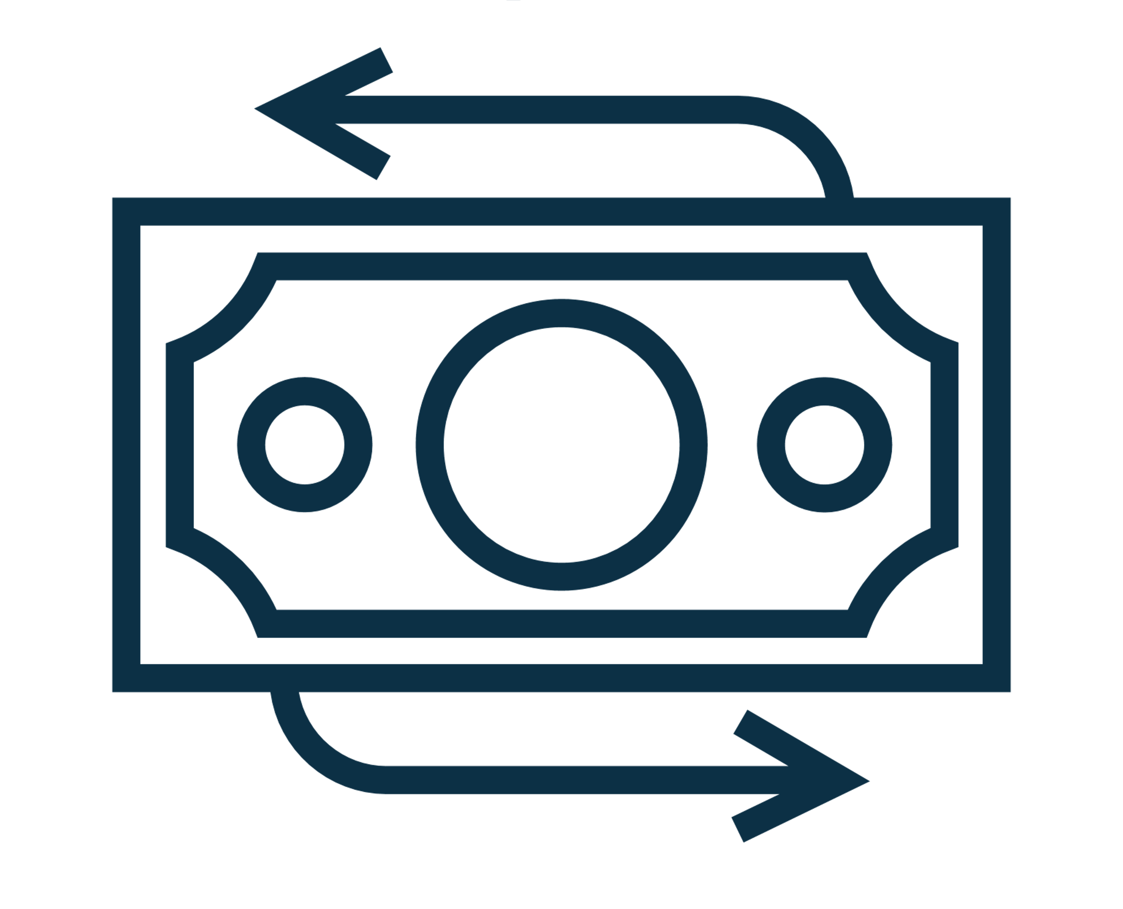
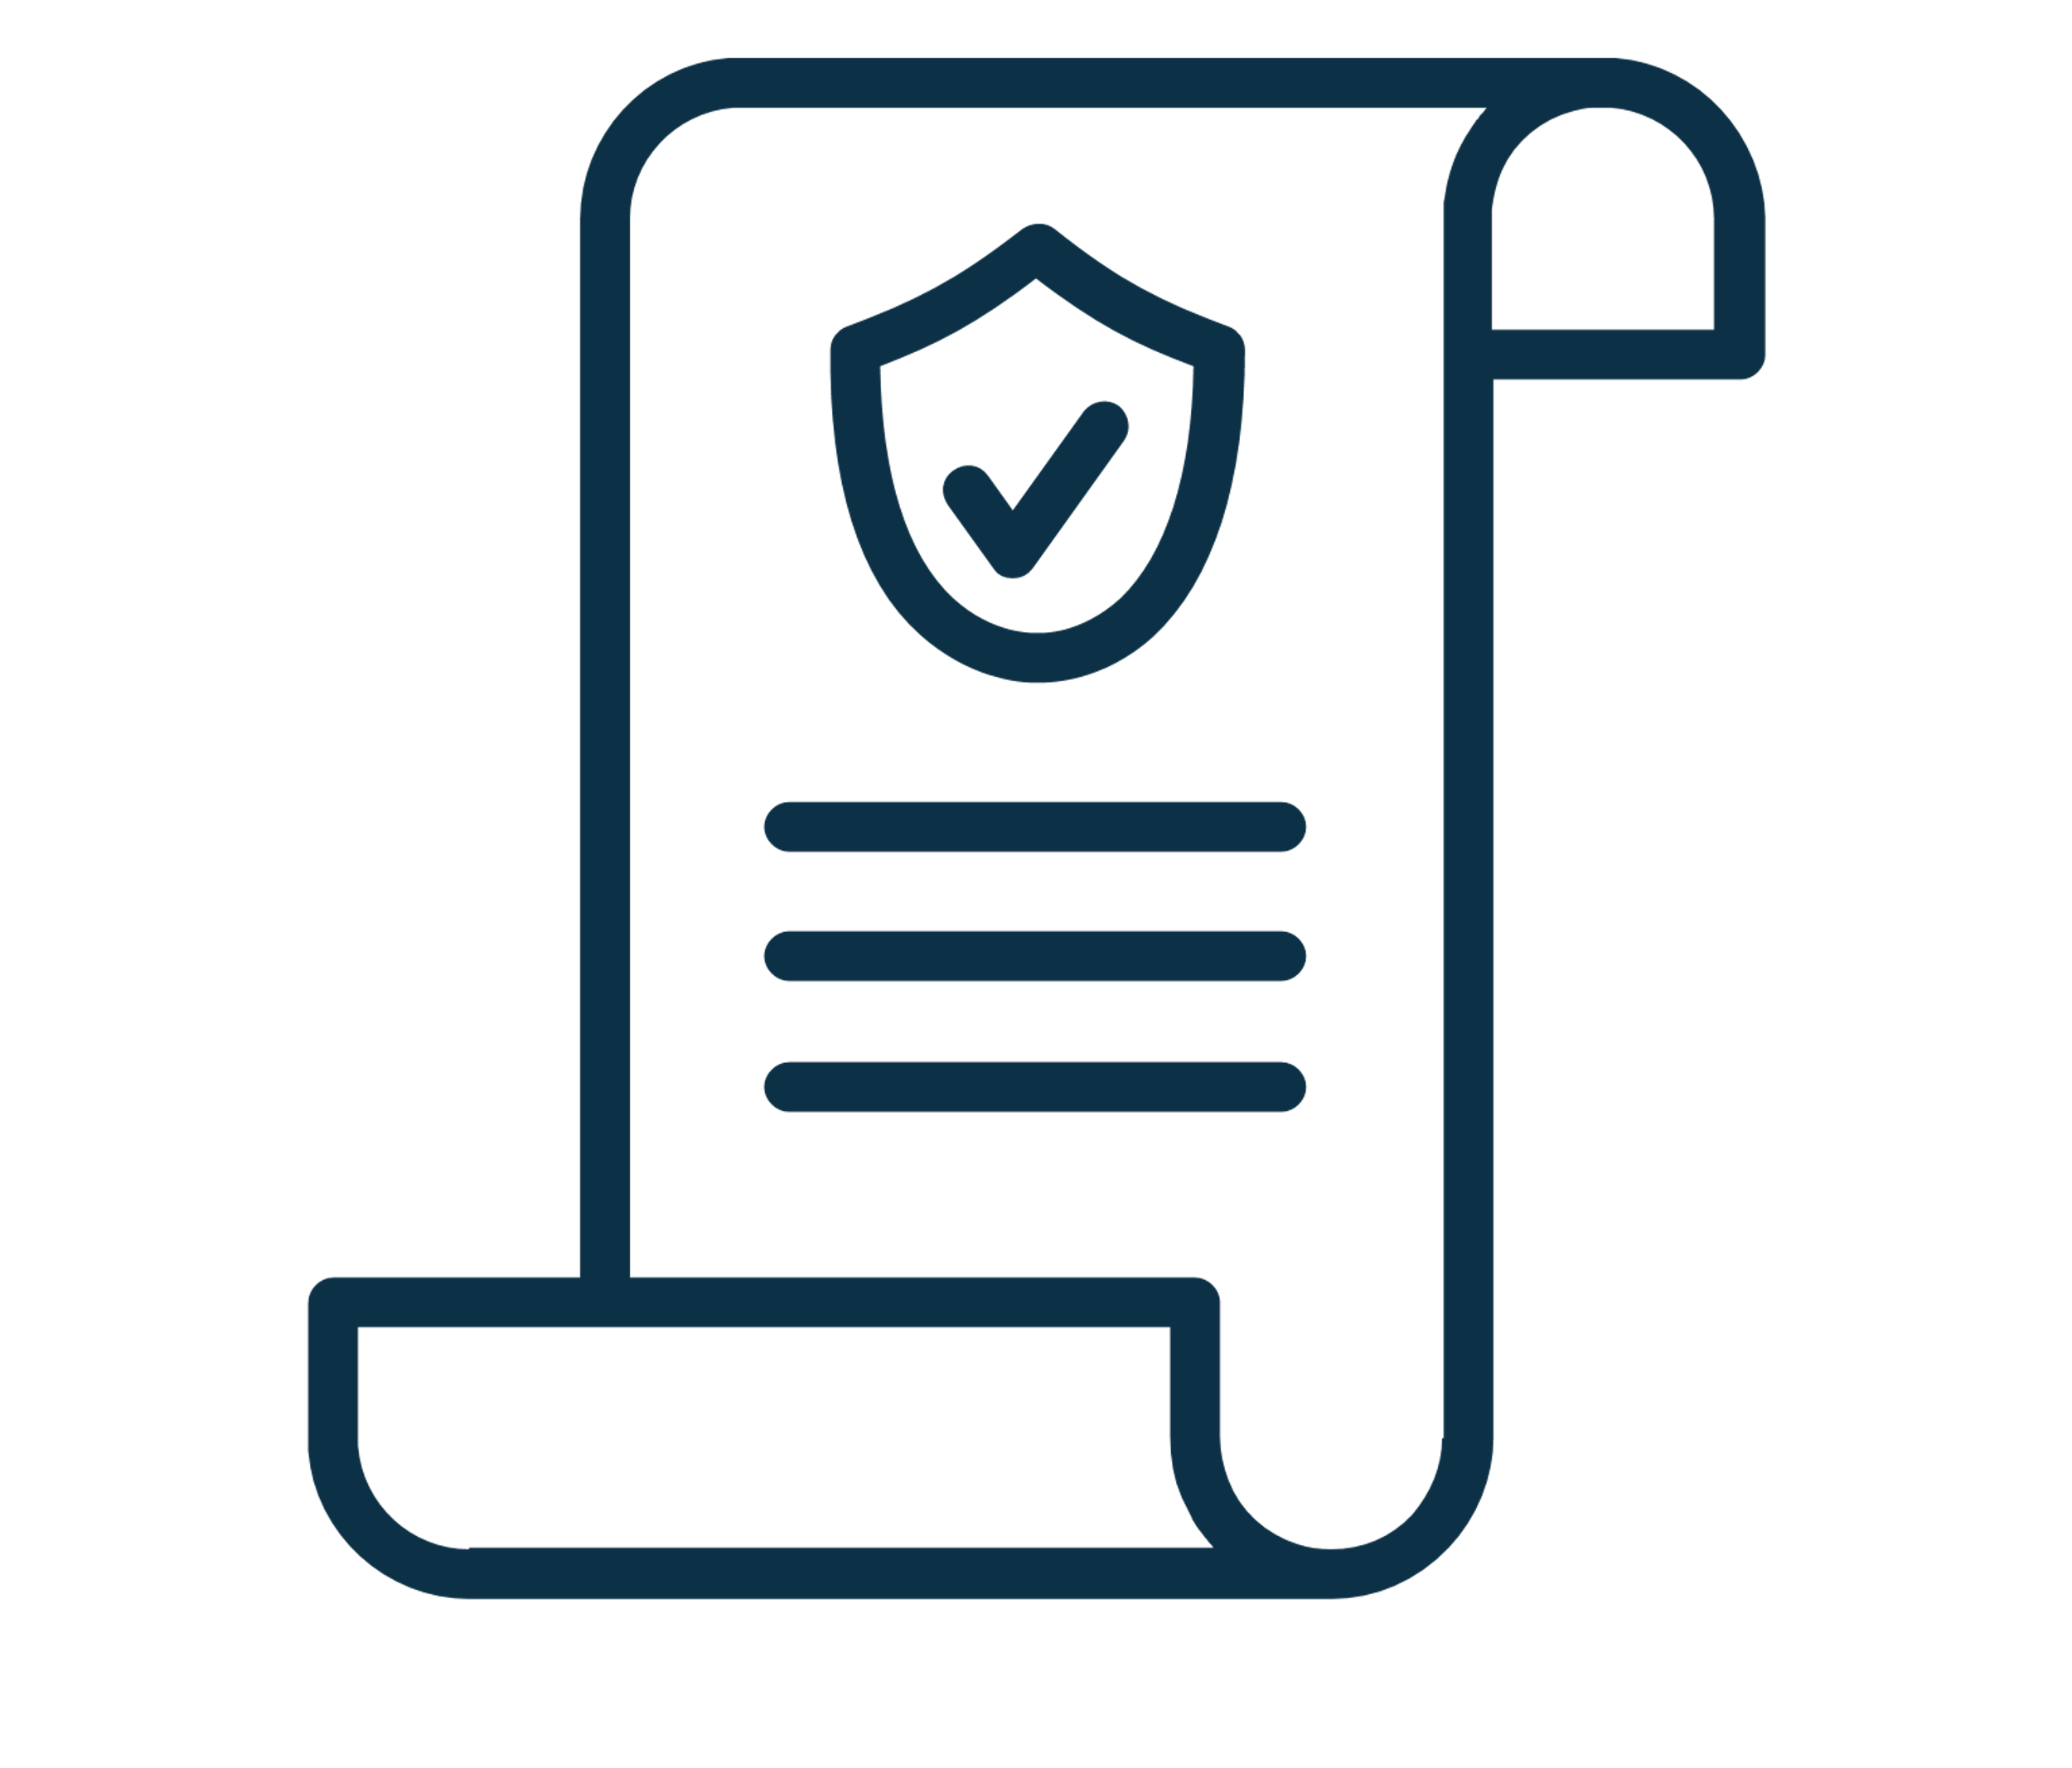
Recommendations: Strategic Pillars
Guarantee of recovery
Advocating policy level changes
Technical and financial literacy training
A mechanism that allows lenders assurance for recovery against value chain actors with insufficient collateral
Ownership transfer for subsidy-based products
Simple interest rate instead of compound
Import incentives
Financial literacy to understand documentation process and record keeping
Technical literacy for machine maintenance and operation

Slide 17
Alternative Financing: Model 1
Challenges addressed
Secondary market
GoB
Difficulty in establishing business model viability by MSPs
Low risk appetite for financing MSPs
High costs of service delivery and difficulty in loan recovery
Low resale value of machines
Replacement of collateral
6: Recall and resell machines
Allow resell before 3 years
5: Buy back at a fixed depreciated rate after n years
Importers
1: Machine sale
Monitor proper machine usage through tracker and allow incentives
Development agencies + Association
Facilitate financial literacy, proper machine usage trainings to ensure higher resale value of machines
3:Failed installments/default
Banks and NBFI
MSPs
4: Repurpose machine and take ownership
2: Loan to purchase agri-machinery
Information
Funds
Machinery

Slide 18
Model 1: Continued
Stakeholder Actions
Stakeholder Incentives
GoB: Allow reselling of subsidy-based machines before 3 years
Importers: Agree to buy-back at depreciated rate and install trackers in machines
Banks/NBFI: Lend for machinery purchase and repossess machines in case of default. Disseminate financial content through e-learning platforms and web based platforms.
MSPs: Attend trainings on machine maintenance and financial literacy and implement the learnings
Development agencies and associations: Partner up with FIs to provide financial literacy training, while associations can give machine related training, and documentation support
GoB: Allowing resell will help popularize the machines
Importers: Help increase the banks’ appetite to finance
Banks/NBFI: Guarantee for default
MSPs: Enhanced financial literacy and record keeping can increase access to finance

Slide 19
Alternative Financing: Model 2
Challenges addressed
Partner with local workshops and foundries to provide after sales service in remote areas
High costs of service delivery to MSPs and SMEs (operational costs
Difficulty in availing after-sales services
High interest rate from MFIs
Low resale value of machines
Lack of credit history for MFI-based borrowers
Workshops and Foundries
2: Fixed commission on sale of machines
Importers
1: Machine distributor/agent with promise by importer to provide after sales service
5:Provide after sales service (web)
MRA
4:Report on machine usage to connect with importers if needed
MFIs (+MFS)
Develop CIB for MFIs
MSPs
3: Hire-purchase loan at lower interest rate to pass on benefits of commission
Information
Funds
Machinery

Slide 20
Model 2: Continued
Stakeholder Actions
Stakeholder Incentives
MFIs: Act as financier and distributor by giving collateral free loans
MFS: Facilitate the MFI collection process
Importers: Pays the MFIs a fixed commission and provides after sales service
Foundries and workshops: Develop capabilities to provide after sales service
MSPs: Accountable for proper machine maintenance
MFIs: Earn commission and also not be burdened with after sales service
MFS: Can also act as disbursement channel
Importers: Greater sales of products and support from local industry to ensure repeat sales
Foundries and Workshops: Greater sales in terms of components for machines that are being subsidized by the GoB and expand to new machines. Increased propensity of FIs to finance
MSPs: Receiving loan at a lower interest rate than before with greater network of after sales service

Slide 21
Alternative Financing: Model 3
Challenges addressed
5. Submission of impact metrics
4. Measurement of impact metrics
Low risk appetite of FIs for financing MSPs
High costs of service delivery to MSPs
Replacement of collateral with impact metrics from investors
2. Machine sale on hire-purchase
Importers
6. Fund disbursement in tranches based on outcome
3.Downpayment+EMI
Impact investors
MSP Group
1. Involved in the process of MSP selection for subsidy based machines along with Krishi office
Information
Funds
Machinery

Slide 22
Model 3: Continued
Stakeholder Actions
Stakeholder Incentives
Impact Investors: Impact investors will provide funding in several tranches on successful achievement of the predetermined targets.
Importer: Importers will have to provide a social commitment by coming up with impact metrics such as Beneficiaries (farmer groups) show improved revenue generating capacity etc.
Foundries and Workshops: Provide revenue based metrics for securing funding
MSP groups: Ensure record keeping of financials
Impact Investors: According to LightCastle study of 100 impact investors, the most important parameters for impact investors are as follows: 22% Project Outcome (Social and Environmental), 15% Sustainability of impact. Future priority sectors for the impact investors include consumer food (17%)
Importer: Since the hire purchase will be availed by a group of MSPs, they can act as verbal guarantor for each other

Slide 23
Way Forward
A policy advocacy for persuading the government to allow reselling of equipment
Organize accelerator programs for ABLE SMEs to enhance capacity and network.
An ERP system for better managing accounts and finances of ABLE SMEs.
An event connecting MFIs with importers and manufacturers where MFIs can become distributors and financiers
An e-learning platform in partnership with banks, that will incorporate basic courses in financial management
A toll-free number to handle queries of value chain actors
Training for equipment maintenance for MFI employees and mechanics

Slide 24
Conclusion
Collaborative approach from all stakeholders including regulators to help improve the financing status of the value chain actors
A multi-pronged approach considering the incentives and risks of each of the involved players must be considered
All financing products have risks, but the risks must be shared among the stakeholders to improve the financial status of the agri-machinery value chain actors to promote greater mechanization in the agriculture sector of the country

Slide 25
THANK YOU

